Slide 1
Small electric vehicles

Slide 2
What is it?
Small electric vehicle is a one-person vehicle that is driven by one, or more, electric engines.

Slide 3
Categories
Electric scooters
Electric bikes
Hoverboards
Electric skateboards
Segways

Slide 4
Advantages and disadvantages of small eletric vehicles
+ | -
Environment friendly | Weight
Lack of noise pollution | Batteries
Charging convenience | Maintenance

Slide 5
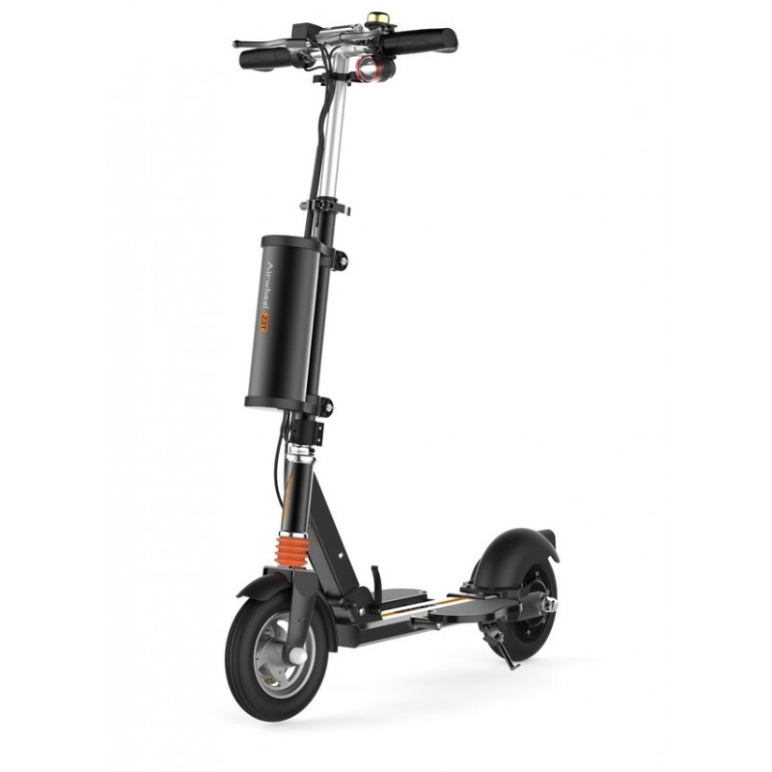
Electric scooters

Slide 6
Advantages and disadvantages
+ | -

Slide 7
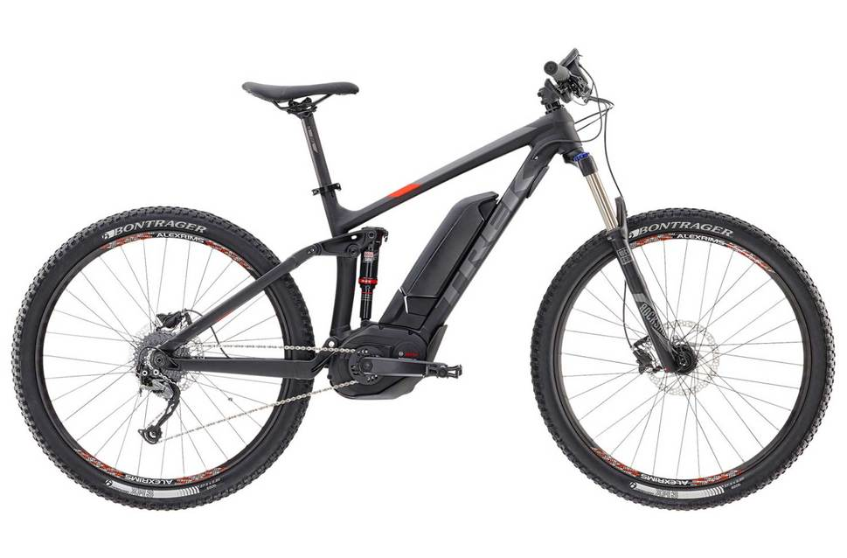
Electric bikes

Slide 8
Advantages and disadvantages
+ | -
Stability
Speed

Slide 9
Hoverboards

Slide 10
Advantages and disadvantages
+ | -

Slide 11
Electrics skateboards

Slide 12
Advantages and disadvantages
+ | -

Slide 13
Segways

Slide 14
Advantages and disadvantages
+ | -

Slide 15
Sources
http://airwheelineurope.com/airwheel/37-electric-scooter-airwheel-z3t.html
http://electricbikeindia.weebly.com
https://static.evanscycles.com/production/bikes/electric-bikes/product-image/969-638/trek-powerfly-fs-5-2017-electric-mountain-bike-black-orange-EV282570-8520-1.jpg

